Slide 1



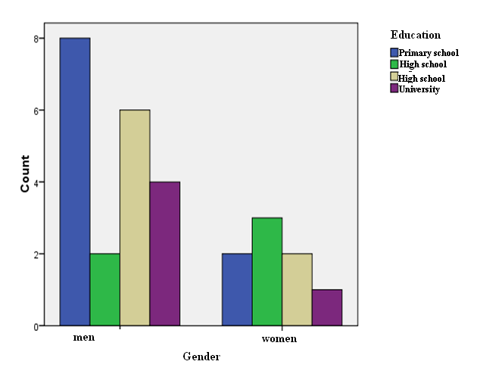
Boston Diagnostic Assessment Examination and Boston Naming Test for Aphasia (short editions) in Greek
Psychometric Evaluation
Atsidakou, M ^{2,3}., Siganou, Z ²., Skoulakari, I.¹, Papathanasiou, I. ^{1, 2, 3}
¹, Division of Language and Communication Science, SHS, City University London,UK
² Department of Speech and Language Therapy, TEI of Western Greece Patras, Greece
³Thalis Aphasia Project, Department of Linguistics, School of Philosophy, University of Athens, Greece
Background
Boston Diagnostic Aphasia Assessment Examination (BDAE) in English is a neuropsychologal battery, primarily focusing on the diagnosis of classic - anatomically based - aphasic syndromes ,through receiving comprehensive samplings of language components ².
BDAE has been published in three versions: in English: the standard, the extended and the short version².
BDAE (short version) was designed as a brief screening assessment tool for several language aspects(i.e. .speech and language production and understanding, reading and writing)based on the standard version of the test².
BDAE was translated and standardized in Greek , in its standard version ¹.
Boston Naming Test (BNT) in English is a neuropsychological assessment tool for measuring confrontational word retrieval².
BNT in English has been published in two versions: the standard version, consisting of 60 items and the short version, consisting of 15 items² .
BNT has been translated and standardized in Greek , in both the standard as well as the short version^{3,4}. The standard version consists of 45 items, whereas the short version consists of 20 items ^{3,4.}
Current study
The present study investigated the psychometric features of BDAE and BNT (short versions) in Greek people with aphasia. The aims of the study were: a) the construction of the short version of BDAE in Greek , based on the standard version of the test in Greek b) the comparison of BDAE short version vs BDAE standard version regarding the appropriateness of the items selected for BDAE short version, c) the comparison of BNT short version vs BNT standard version regarding their psychometric properties.
Results
Standard BDAE-short BDAE (initial assessment) Standard BNT-short BNT (initial assessment) | ICC = 0.964 ICC = 0.985
Standard BDAE-short BDAE (re- assessment) Standard BNT-short BNT (re-assessment) | ICC = 0.967 ICC = 0.983
Test-retest BDAE short Test-retest BNT short | ICC =0.962 ICC=0.981
Method
Participants
BDAE and ΒΝΤ were employed in 30 participants, in both the standard and short version. Participants were aged between 33 – 82 years old , with their educational level ranging between 6 - 16 years.
Participants were Greek native speakers, diagnosed with aphasia as a result of a stroke. All participants were receiving speech and language therapy during the assessment period.
Material
BDAE and BNT in Greek , in both standard and short version, were employed.
BDAE ‘s short edition in Greek was designed based on the standard version of the test, omitting certain subcategories or specific items, however, allowing full language evaluation of all aspects (i.e. speech and language production and understanding, reading and writing), by using stimuli with hierarchical degree of difficulty.
Procedure
Participants were divided into three groups. Each group consisted of 10 participants, assigned to a different examiner.
Participants were initially assessed , using both the standard and the short version of BDAE and of BNT in Greek.
15 days after the initial assessment, participants were reassessed using the same tools, however, by a different examiner. Employing different examiners was to ensure fidelity.
Analysis
Results were analyzed using SPSS 17.0. Specifically, the correlations between the standard and the short versions of BDAE and of BNT respectively were estimated.
Descriptive for age
Educational level relative to gender (Ν=28)
Age (N=30)
Mean | 58,5
SD | 12,3
Minimum | 33,00
Maximum | 82,00
Conclusions
Both BDAE and BNT (short version) seemed to detect the same difficulties in communication as do BDAE and BNT (standard editions), regardless of whether the protocols were administered by different examiners and/or after a certain time period.
Τhe protocols were administered to participants of different gender, age and education level, suggesting that the short edition of both BDAE and BNT could be equally effective and reliable as their standard editions when administering to different populations.
Results on ΒΝΤ agreed with previous findings, indicating a significantly high correlation between short and standard , irrespective of age⁴ .
Further research is needed in order to explore in more detail the sensitivity of BDAE and BNT short versions to change and their appropriateness for use as a clinical outcome measure.
 |  | Education
 |  | Primary School | High School | High School | University | Count
Men | Count | 8 | 2 | 6 | 4 | 20
 | %within gender | 40,0% | 10,0% | 30,0% | 20,0% | 100%
Women | Count | 2 | 3 | 2 | 1 | 8
 | %within gender | 25,0% | 37,5% | 25,0% | 12,5% | 100%
This research has been co-financed by the European Union (European Social Fund – ESF) and Greek national funds through the Operational Program "Education and Lifelong Learning" of the National Strategic Reference Framework (NSRF) - Research Funding Program:
THALIS – UOA - "Levels of impairment in Greek aphasia: Relationship with processing deficits, brain region,
and therapeutic implications", Principal Investigator: Spyridoula Varlokosta.
References: 1. Papathanasiou, I., Papadimitriou, D., Gavrilou, V., Mihou, A., (2008). Psychometric propertis of BDAE in normal adult population: the effect of age and gender (in Greek). Psychology 15, 398-410 (Greek edition). 2. Spreen, O., & Risser, A. H., (2003). Assessment of Aphasia. Oxford University Press, , 123-129, 61-67. 3.Simos, P. G., Kaselimis, D. & Mouzaki, A. (2011). Age, gender, and education effects on vocabulary measures in Greek. Aphasiology, 25 : 4, 475-491. 4.Simos, P. G. , Kasselimis, D., & Mouzaki, A.,(2011) 'Effects of demographic variables and health status on brief vocabulary measures in Greek', Aphasiology, 25: 4, 492 — 504.

